Slide 1
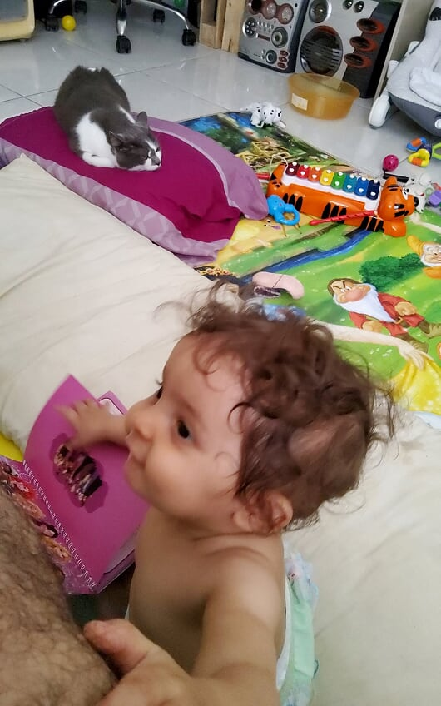
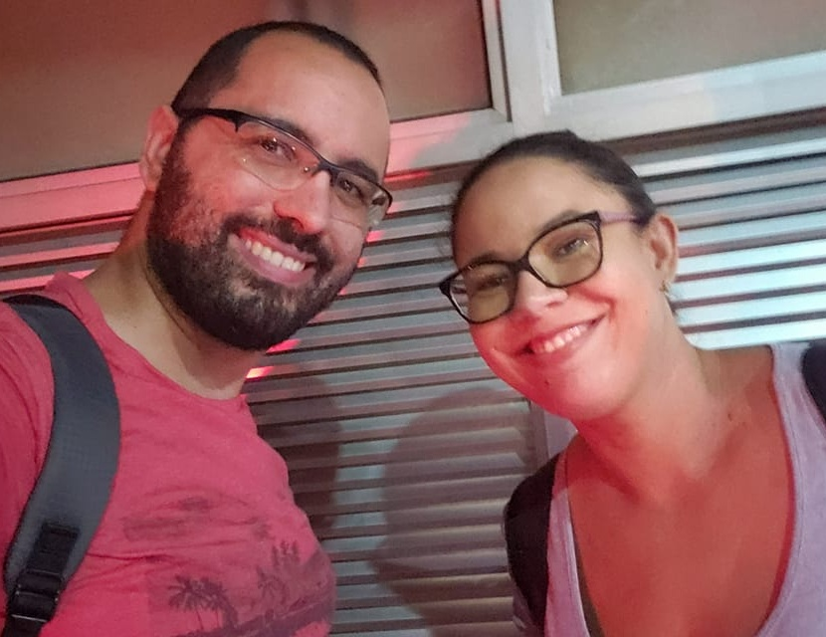
Notes:
So, my first talk! Hi! This is me! My name is João Ciocca, but you can call me Johnny – I know it’s easier in English.
I’m married and a fresh father – she’s our 11 months old baby girl, he’s our rescued pain-in-my-ass cat.
I have academic degrees in Network Administration and Information Security.
I worked as Information Security Coordinator for the Federal Public Defense back in 2016
I work at Caixa, Brazil’s federal state-owned bank, since Feb 2004...
But Caixa is a HUGE place with banking branches all over the country, and I can safely say that I’ve had at least 10 different jobs in there, from branch routines and customer service, moving on to web design and blogging, than further away with database and ETL works.
I’m currently Caixa’s CSIRT technical supervisor, focusing in training our team and testing tools to improve our daily routines.
I help our coordinator handle our incident response team along with a process supervisor colleague.

Slide 2

Notes:
Allow me to dive a little in my history.
Last year I was a volunteer on Roadsec, a Brazilian infosec convention that runs through the whole country.
I was invited for some of the other editions to check things out and loved it, the talks, the people, the energy!
So, I decided I wanted to see the other side of it. When last year’s edition happened here in Florianópolis, I enlisted – and then, in the last minute, change of plans: I’d be their master of ceremonies.
When this year started, I decided that I’d try to move up on that – I wanted to give a talk, but I had no idea what to do!
The amazing Lesley Carhart had just announced #pancakescon and I told her I’d love to submit a CFP but had no idea to present.
She helped me out on Twitter with a single idea: “If you were sitting at a bar with somebody who knew little about infosec, what would you tell them about?”

Slide 3
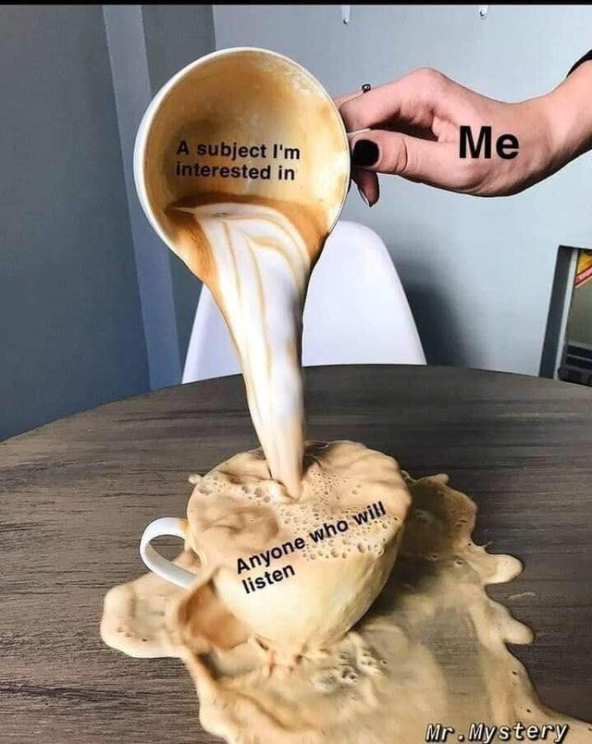

Notes:
Passwords. And vaults. I just love the subject – even if I don’t have too much time or math background to study more about it.
Besides, I like even more the human context to them! How people deal with authentication methods?
How they come up with password ideas? What are their restraints, and how they deal with them?
But I always thought it was such a beaten-up subject, it never occurred to me to talk about it. And so I submitted my first CFP to #pancakescon

Slide 4
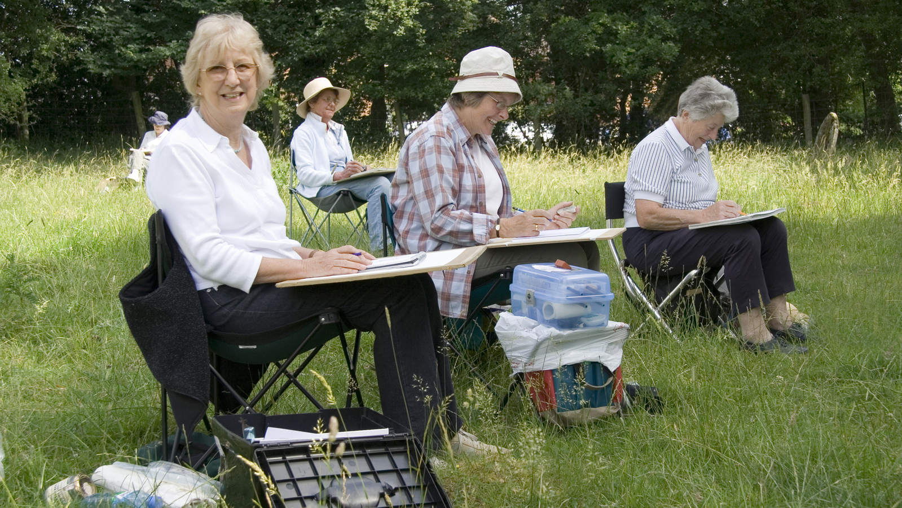
Notes:
Then, part two was to talk about a hobby. And I kept thinking that, except from playing games, I didn’t think I really had a hobby.
I mean, 9h/day at work, wife, baby girl, cat. The little free time I have I’m messing with some random project that don’t really matter or playing.
But then it hit me: I like to mess around my home. I know my way around tools and little fixes…
For Pancakes I tried submitting something about changing a power outlet, I think. It’s something I do every time when I move – I could never find a place where their power outlets have triple exits, and so I buy new ones and change them all away!
Sadly, it wasn’t meant to be – EVERYONE wanted in on #pancakescon, and they had around 250 submissions for 23 slots! But I wasn’t going to give up.

Slide 5
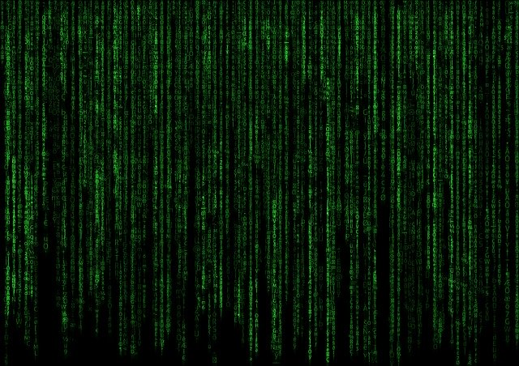
P@$$w0rd V4u1t5 and (Dead Routers)
Notes:
That was when I saw Grimm advertising their #GRIMMCon CFP and I thought “let’s try that again”. So here we are!
Password vaults and dead routers. I’d like to point, for those who’ve seen Grimm’s ad about this presentation on social media, that they have absolutely nothing to do with each other. No relationship at all, at least regarding this presentation.
If you came to watch because of that, I’m sorry to disappoint.
But stay awhile and listen, there may be something interesting here for you!

Slide 6

Notes:
To start things up – one of the things I hate most about passwords is how we’re still attached to old guidelines from times gone by.
I do know that sometimes they’re necessary because of system limitations, but even those have solutions.
Bill Burr talked to the Wall Street Journal about his regret on NIST’s infamous special publication 800-63 Appendix A guidelines, and how he felt his advice back then did more harm than good.
Frequent password changes led us to using weak patterns that we can memorize for daily usage.
Forcing the use of special characters led everyone to alphanumeric replacements.
So many accounts, how can any regular person use different passwords for each of them?!
But he was too harsh, we didn’t know back then what we know now – it’s easier to be harsh when looking in hindsight than to correctly predict the future.
Last paragraph of the first part of Appendix A clearly states that they didn’t have much data on passwords users chose back then!

Slide 7
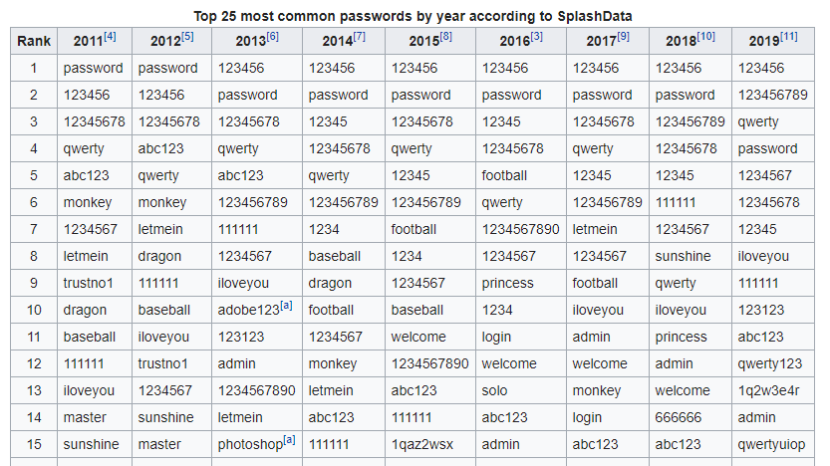
Understanding
Notes:
I like an old quote that says: “Understanding is a three-edged sword: you side, their side and the truth”.
One side is in the past, no one back there had the knowledge about password usage we have today.
Another side is what happened, people using patterns and reusing the same password in a gazillion websites.
The truth, as I’ve mentioned, is that the underlying data available has changed, what we know has changed, what we can see has changed!
Understanding this, we can move forward!
Ok, so NIST didn’t have enough data? Now we have a Wikipedia article on the most common passwords. Sorted by year.
We have websites dedicated to listing the top 10 THOUSAND most common passwords. With their MD5 hashes.
“Oh, but I change my letters for special characters, Johnny!”
Well, I’ve got some news for you…

Slide 8
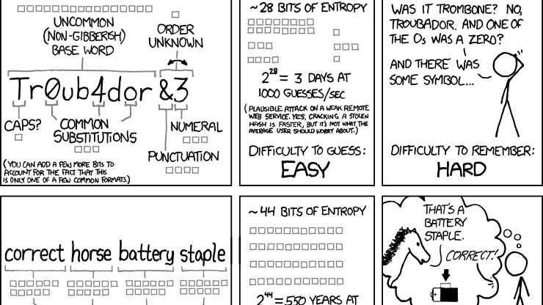
Harder, Better, Faster, Stronger
Notes:
You probably have seen that XKCD comic that’s on the background, right?
For those who haven’t, they talk about entropy based purely on the length of the password, and how entropy goes directly to password strength.
The uncommon base word “troubadour” becomes that substitution mess.
Can you remember it? Ok, now a month later you must change it. Oh, and you shouldn’t reuse the same password for different services.
E-mail, a few social networks, the newspaper you like, your music subscription service, your video streaming service, you cellphone PIN, your work account password – and I say that considering there’s only a single system in your work, or that they have single sign-on or some sort of password sync solution in place.
First thing that happened in this scenario was that 78% of users in the last 90 days used the “I forgot my password” mechanics, according to a HYPR study last year.
Second thing that happened was password reuse, which led to credential stuffing – with 73% of users having duplicate passwords, according to LDAPWIKI.
Hbfs2019 – 2 hours
Hbfs@)19 – 9 hours
Harder Better Faster Stronger – 385 decillion years

Slide 9
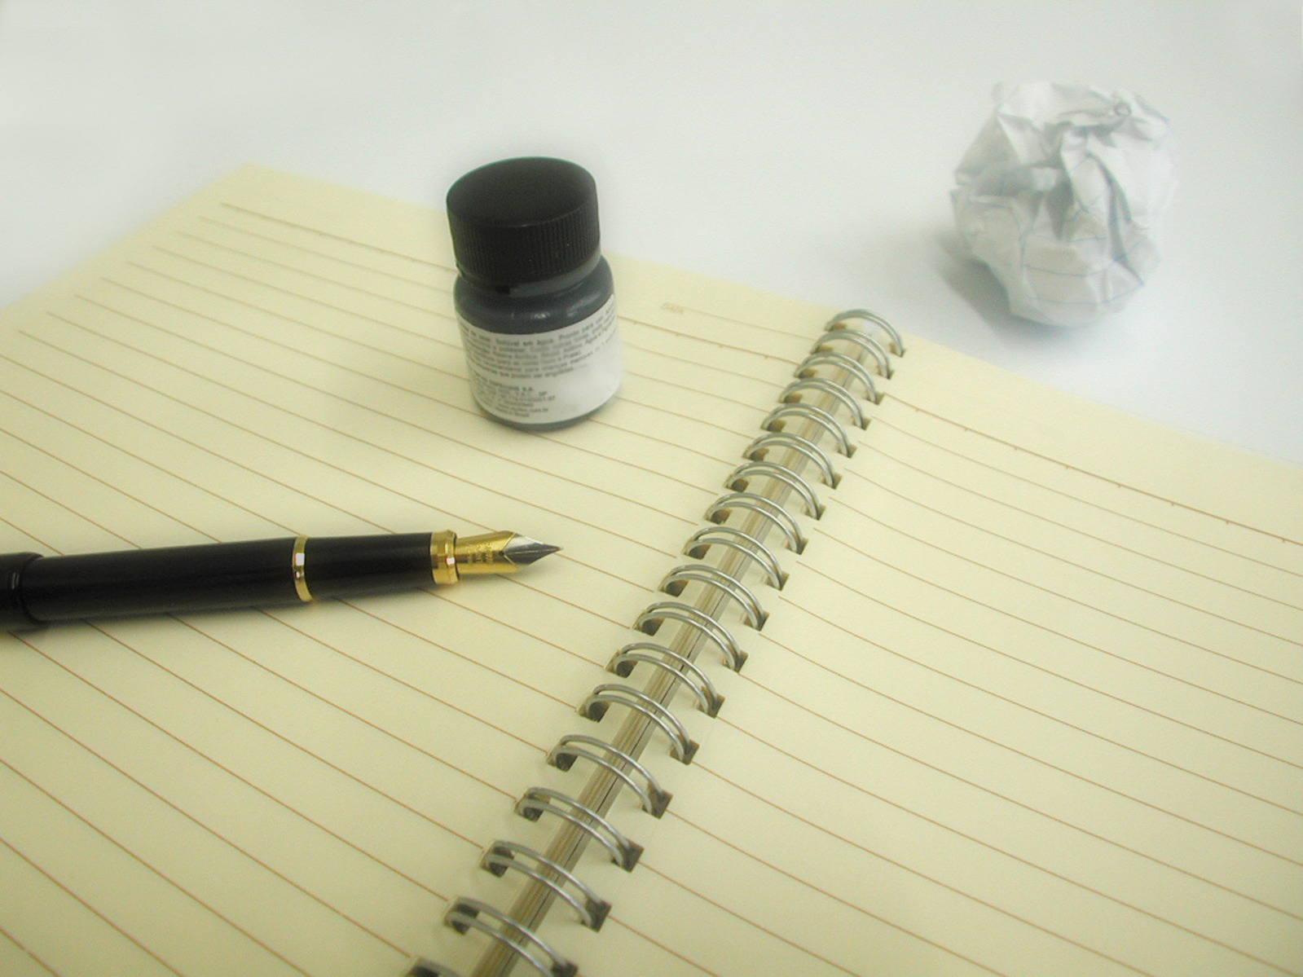
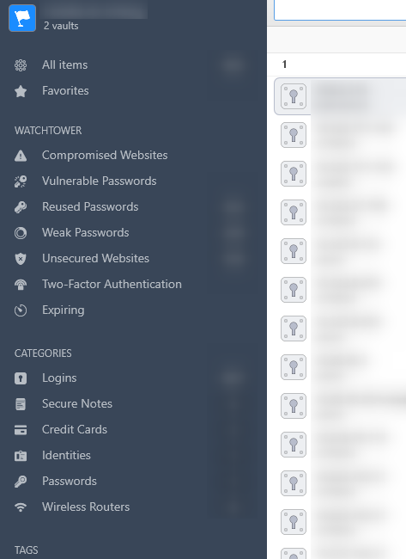
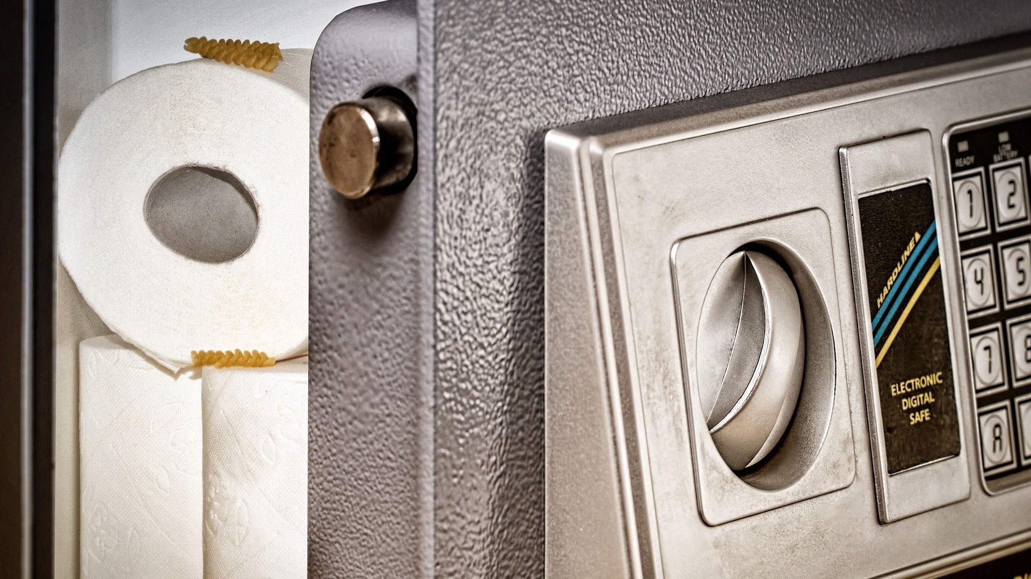
Vaults
Notes:
Enters a solution for most of those problems: password vaults.
You need to remember only one, preferably huge, probably composed of multiple words. A passPHRASE and not passWORD anymore.
The vault deals with the rest. You don’t even need to know or memorize those bastards anymore!
Need a new password for that Other Social Network? Done!
Another one for you hidden e-mail account? Why, here it is!
Lots of different flavors: open source, proprietary, free to use, subscription-based, single device or cloud synced between desktop and mobile devices.
You can go full ease of use or completely secure paranoid on a thumb drive that never access the internet.
You can even make your own offline vault with pen and paper!
And as my coach reminded me, if you have people snooping through you bag for passwords, that’s an HR problem, not an IT one!

Slide 10
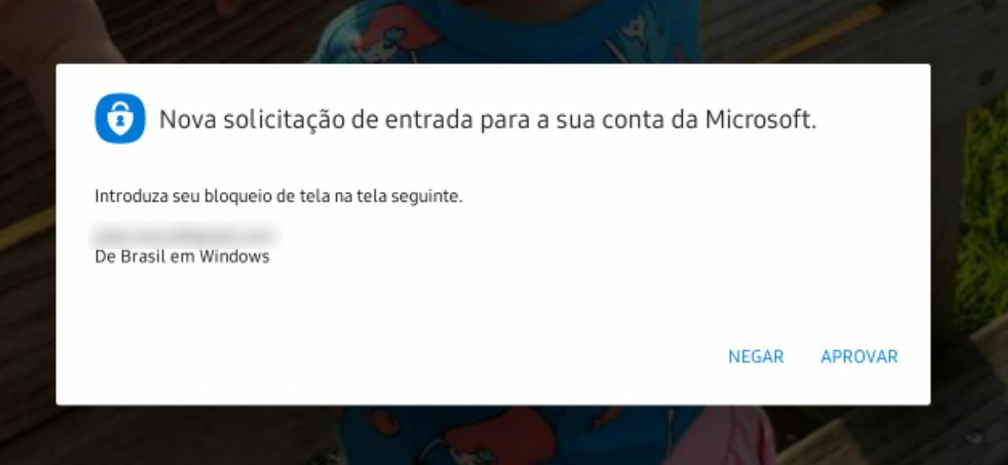
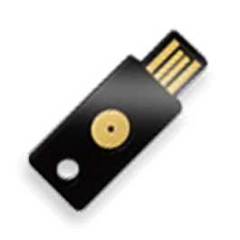
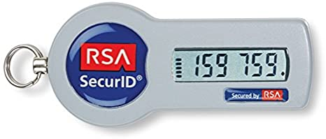
Not vaults?
Notes:
Remember I said “most”? Vaults aren’t a silver bullet – nothing ever is, don’t ever believe in one outside of entertainment – games, TV, movies, etc.
Anyway, Vaults - They don’t work everywhere and aren’t meant for everyone.
There are also solutions that aren’t related to vaults at all, with Microsoft’s passwordless authentication using their Authenticator app,
2FA solutions like RSA SecurdID or other token OTP generator apps and gadgets, and let’s not forget FIDO-enabled USB tokens – all of those are alternatives for authentication and they can complement each other.
We can talk more about this later, if you’d like, because that wraps up the first part of my presentation!

Slide 11

Notes:
So, I think we all have at least one dead router stuck on some closet or box, right?
I had this little guy. It was pretty good, had decent specs, 64MB, USB, SAMBA, FTP, torrent support… all this back in 2012, here in Brazil, on a cheap thing!
Then a lightning hit and, apparently, all its ports burned – and I think part of my brain burnt along with them, hang on and I’ll explain why.
I mean, I couldn’t get any port to connect to it, you know? There were LEDs blinking when I turned it on, but that’s about it.
Threw it in a closet and forgot about it.

Slide 12
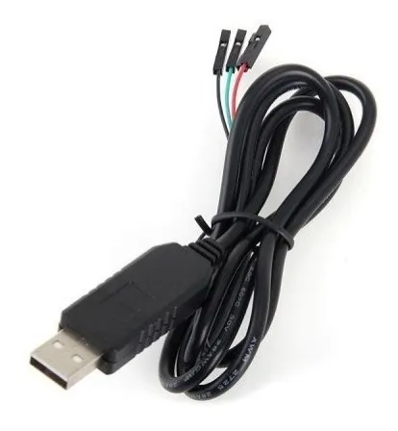


Notes:
Fast forward a few years and I find myself reading about open source firmware and one of the things was about using console access through UART to access a non-responsive router!
I thought maybe that could fix all my troubles! Got myself a USB-UART cable and WOULD YOU LOOK AT THAT. First steps I followed from some forum post and bam! LAN ports were working!
But the WAN port was no good, nothing worked for that. Completely toasted.
Reading some more and I thought that, maybe with the open firmware, I’d be able to route the WAN function to one of its LAN ports…
But after searching, and investigating its pieces, I couldn’t get any WRT image that would work on it, even thought about learning how to customize one, but it was SO DAMN HARD.
I did spend about a week trying to figure out how to deal with it, but it was out of my league.
Eventually, I settled with having resurrected it with its stock firmware, and there it went to the closet again.
Fast forward some more years and I was randomly reading stuff on the internet and a light flashed in my head, and that part of my brain that got fried along with the router suddenly came back to life!
Its LAN ports still work! If its LAN ports work, it could work as a switch, right? And I could use its Wi-Fi, right?
So… let me back a few months now because this actually happened right at the start of this quarantine!

Slide 13

Notes:
Last year, right after Black Friday, Amazon still had a deal for the Echo Dot and I’ve been dying to check it out.
I always wanted to play with voice assisting and smart lighting. Got myself an Echo Dot, went to AliExpress and bought some cheap lights.
Got each one from a different manufacturer, just to test them out! Turns out there’s no big deal, you make a one-time setup with the manufacturer’s app, sync it to Alexa and it’s done. You never need those apps again. That was then…
Now, after some more reading, I found out there are some options out there where not even the manufacturer’s apps are needed, like HomeAssistant.io
Anyway, back on track: everything arrived quickly – but this all happened BEFORE I remembered about switching!
Wi-Fi signal at my home office was awful, the Echo Dot barely worked!
I tested the smart lights at the living room where Wi-Fi was good, and it worked superb.
At the home office? No deal, they wouldn’t even connect – and so they reverted to dumb lights.

Slide 14
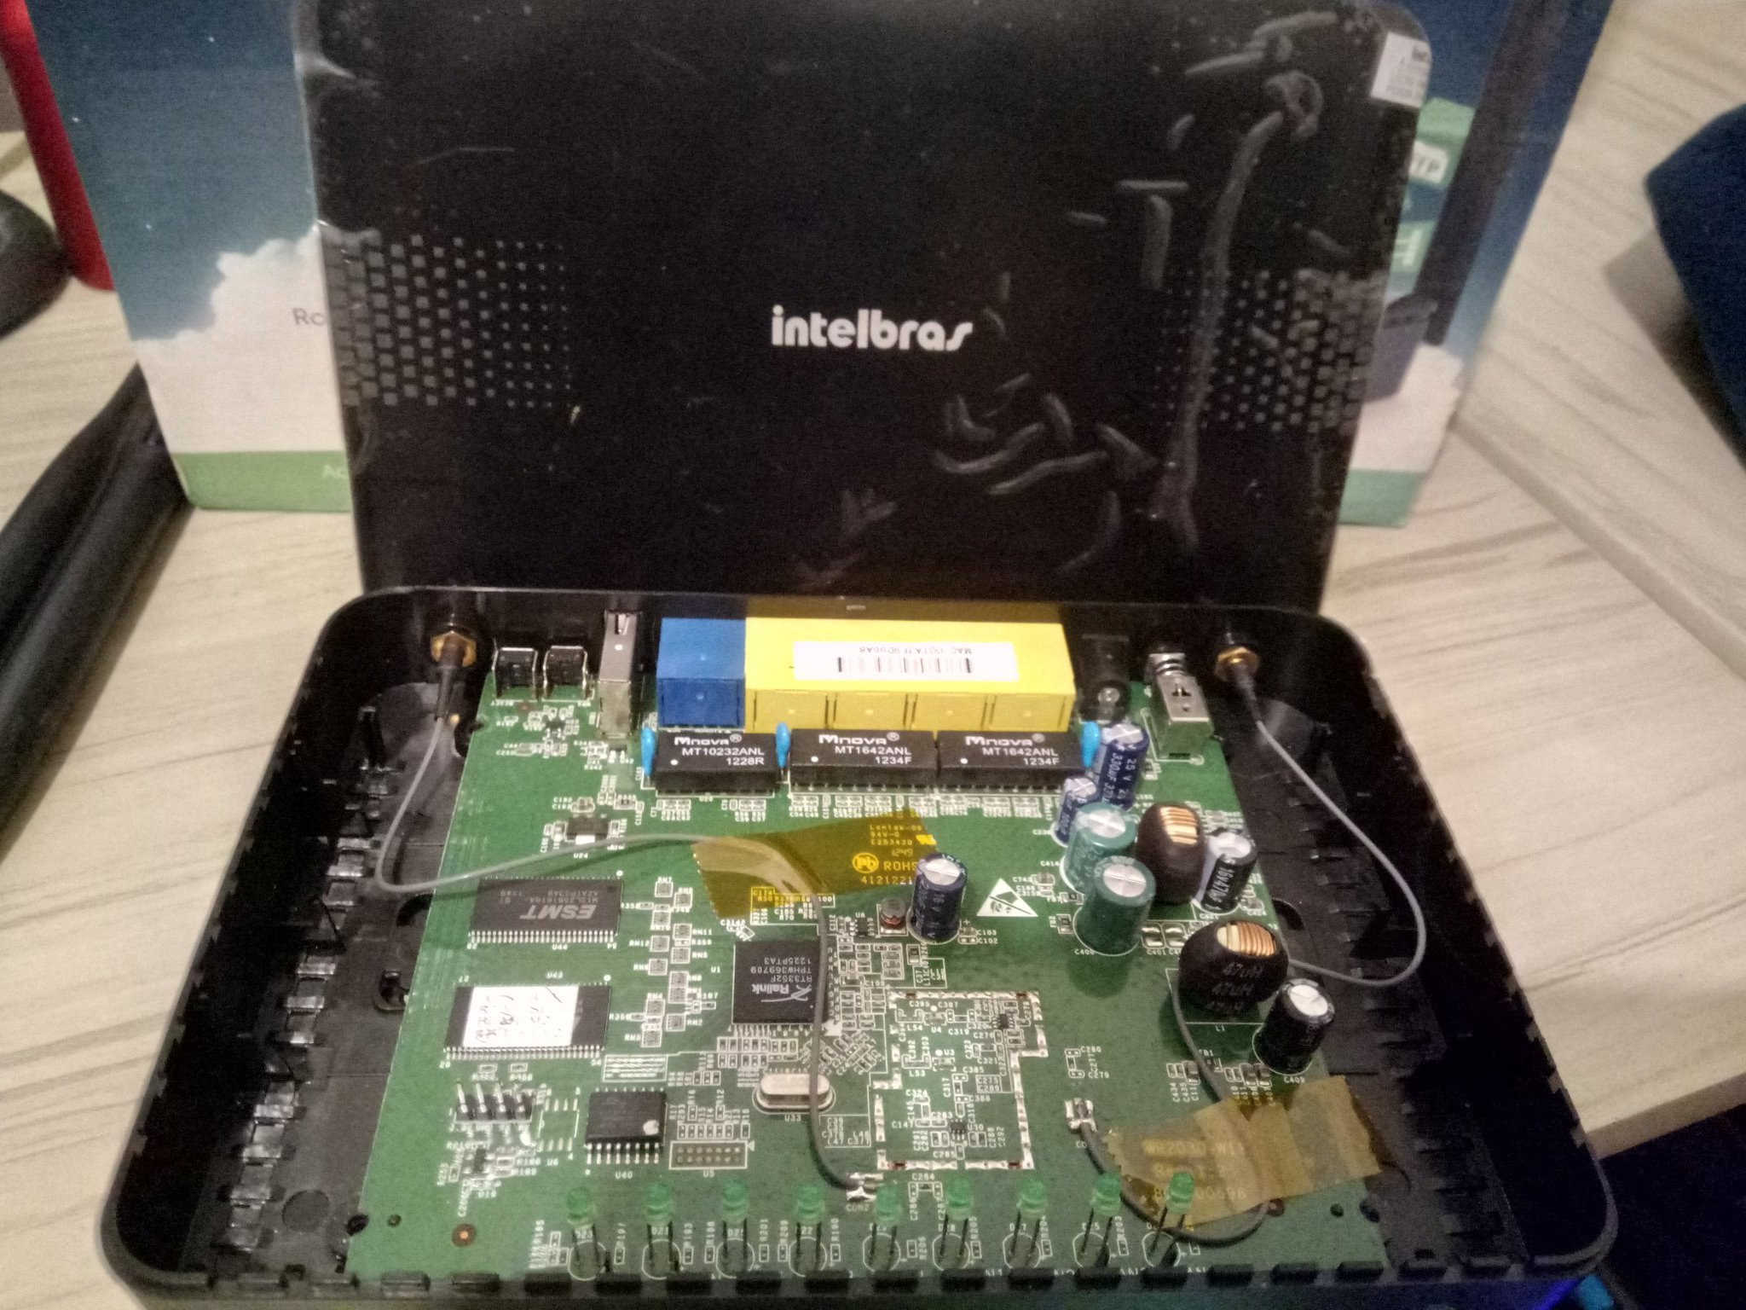
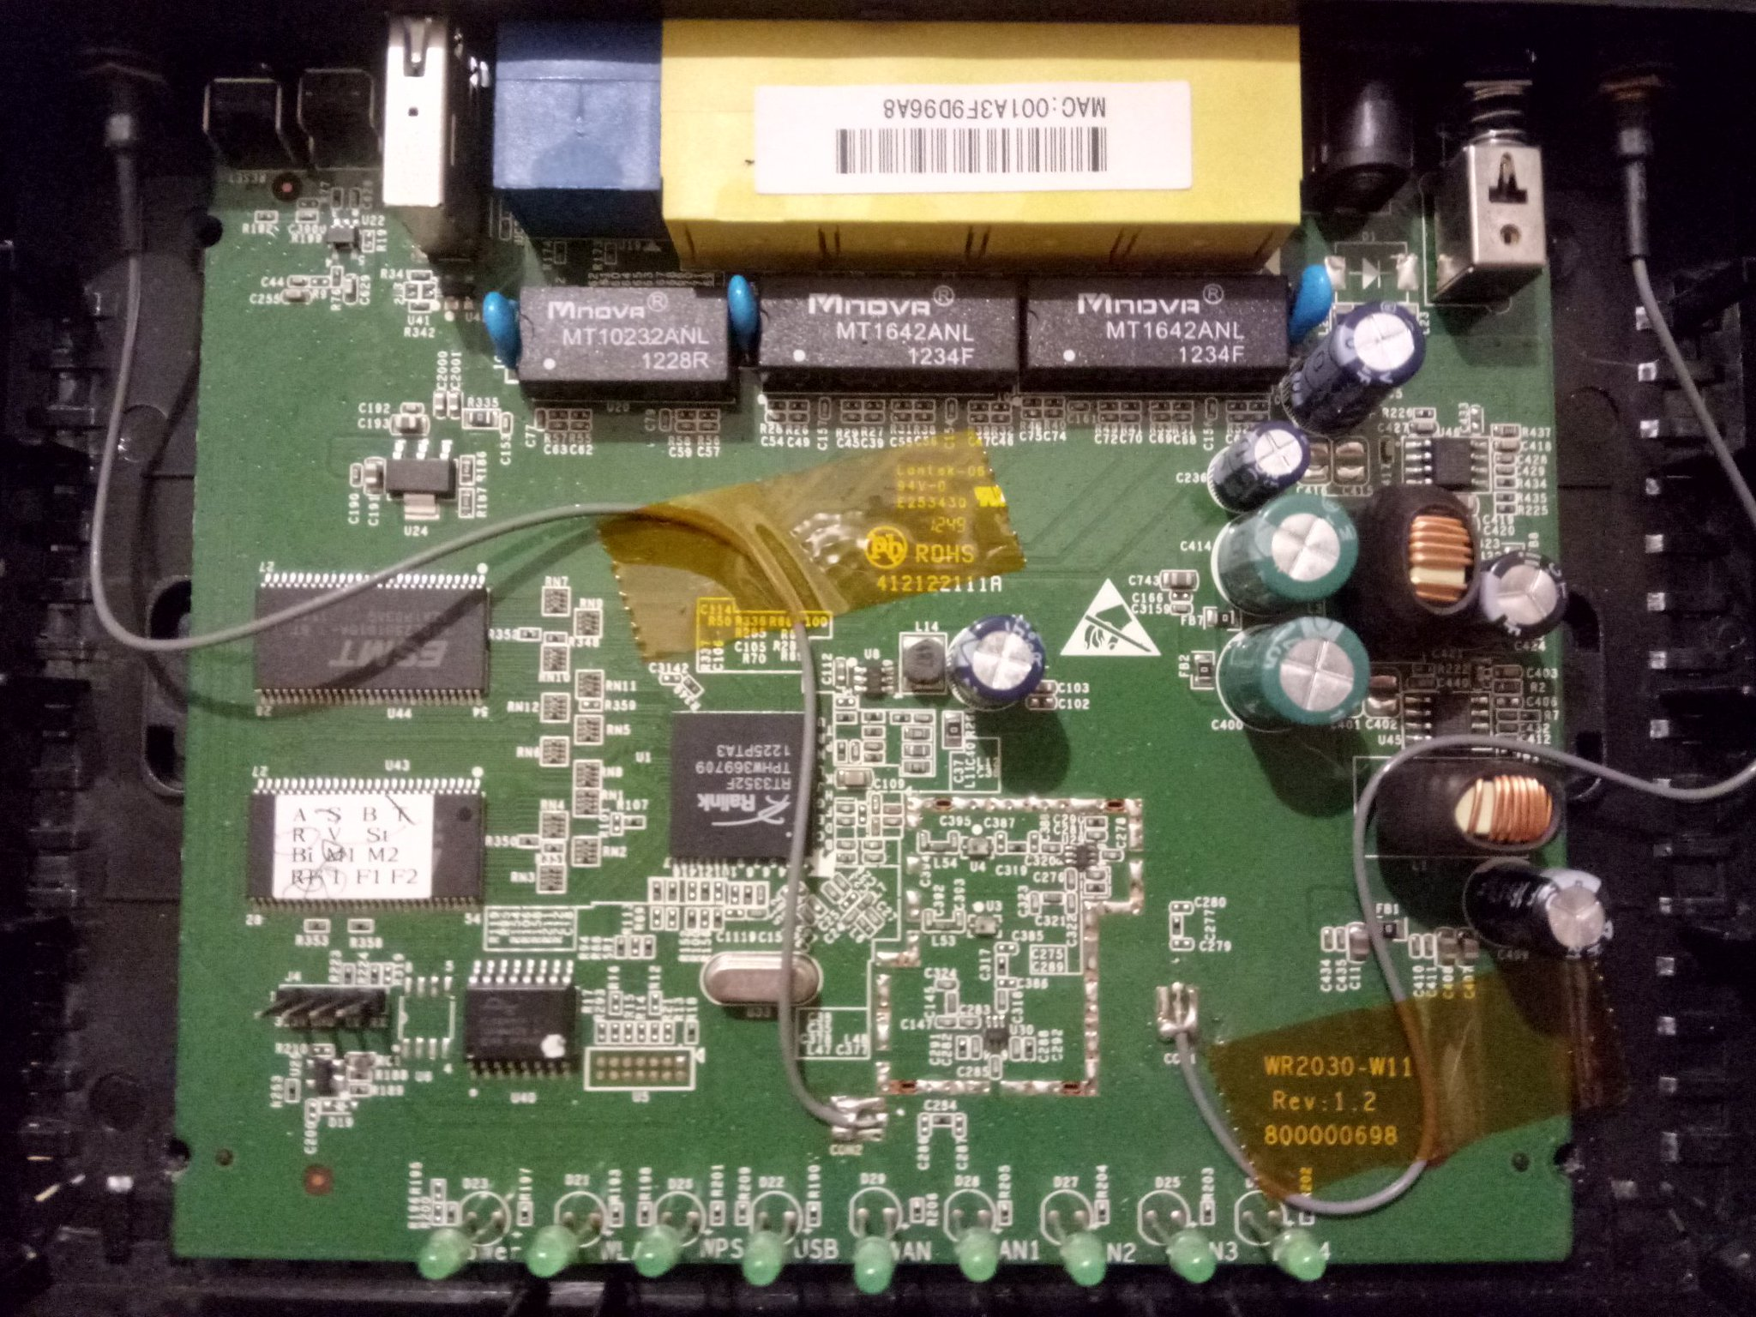
The Little Guy
Notes:
ENTER THE RESURRECTED ROUTER! I already had a huge cable coming from the living room to my home office for my old desktop, it was just a matter of putting that cable on the router and setting things up! I even used this to properly setup my internal network, changing default equipment passwords, checking for eventual exposition of web interfaces and moving away from 192.168.0.1!
Now I got myself a fast replying Echo Dot, working nicely with the lights. I have good morning and good night routines, I set up 4 or 5 sunset-linked routines that change the brightness and color of my lamps! And I can’t wait to see what else I’ll be doing with this >:)
Oh yeah, I bought a smart universal infrared controller so, probably, the next step will be changing channels on my dumb TV using my voice!
But I know I won’t go as far as this guy I watched the other day, that has so much automation at home he even implemented an ESCAPE GAME.
It looked awesome, but waaaaaaay out of my interest!

Slide 15
New Speaker
Notes:
So, I’d like to make a few comments and share how was this new speaker experience for me, if you guys don’t mind.
First, there was cam and mic test with Renee and Christophe, from Grimm. Along with testing video and audio, they gave some amazing feedback about things to improve – for example, using my headset instead of the notebook’s speakers and microphone, putting up better lighting or something behind so that my home office won’t distract the attention of my audience.
That was really awesome, I had never thought about stuff like that this way before, even if I already had done meetings with friends and work colleagues before.
Then, there were the slides review with Chris – he mapped out a lot of stuff I could improve, and it made me realize I had never before thought about searching on how to make a good presentation. On the second revision he already told me it had improved a lot – I was really proud of that.
My first test run with Chris ended with the timer hitting 12 minutes and something. He said there was a lot he’d like to hear me talk about, since there was so much time left and I thought it would be easy to double on that.
My second test run was to myself. I swear I added a lot of details, doubled the number of slides and…
Twelve minutes. I was looking at the screen thinking “How the hell did this happen?!” and that was all the reaction I could muster: staring at the screen for a while.
You see, one of the things I thought I’d do was make a better use of my camera being on the notebook, and I could use its screen to keep my speech at sight and read it – English isn’t my native language, so I’m better at reading than going through the motions. But I thought that maybe adding some points where I could expand without written text could help beef those 12 minutes up.
As I write this, I’m wrapping up a new version to send to Chris and I clocked 22,5 minutes so far. I think I’ll leave those other 7,5 minutes for Q&A.

Slide 16


@JohnnyCiocca
Notes:
So, this is it. You can reach me at Twitter or Telegram, with the same handle.
I’d like to thank Grimm Cyber for hosting this GRIMMCon and having me aboard for my first talk. I also would like to thank Chris Dale for being my coach on this.
And, if we have time, I’m available for some questions!

